Slide 1
Redis – A Fermi Crash Course
Robert Santucci
Accelerator Directorate | Instrumentation
9-19-23

Slide 2
Setup and helpful links
docker pull redis
docker pull redislabs/redisinsight
docker run -d --name redis -p 6379:6379 redis:latest
docker run -d --name redis-insight -p 8001:8001 redislabs/redisinsight
Open a web browser and navigate to 127.0.0.1:8001
https://redis.io/
https://redis.io/docs/clients/python/
https://github.com/sewenew/redis-plus-plus
https://ghe-pip2.fnal.gov/adinst/RedisAdapter
https://github.com/bigsamich/RedisCrashCourse

Slide 3
Quick Overview
Redis - What it is and what it isn't
Data structures
Pub/Sub and Streams
Common design patterns
Pitfalls
Redis Modules
AD Instrumentation Redis - Current usage

Slide 4
Redis – REmote DIctionary Server
What it is:
In-Memory Data Structure Store: Redis primarily stores data in memory, which allows for incredibly fast read and write operations.
Supports Multiple Data Structures: Beyond just key-value, Redis supports lists, sets, sorted sets, hashes, bitmaps, and geospatial indexes.
Versatile Tool: Can* be used as a database, cache, and a message broker.
What it isn't:
Not a Primary Disk-based Database: While Redis has disk persistence features, it isn't designed to replace traditional, disk-based databases.
Not Geared for Complex Queries: Unlike SQL databases or certain NoSQL databases, Redis isn't built to handle complex queries or joins. Data modeling and structuring should be carefully considered.
Not a Silver Bullet: While Redis is versatile and powerful, it's not always the right solution for every problem. Using Redis when a relational or traditional NoSQL database is more appropriate can introduce unnecessary complexity.

Slide 5
Redis – Data Structures
Strings: Simple key-value pairs.
Set: SET key value
Get: GET key
Lists: Ordered lists of strings.
Add to tail (right): RPUSH listKey value1 [value2 ...]
Add to head (left): LPUSH listKey value1 [value2 ...]
Pop from tail (right): RPOP listKey
Pop from head (left): LPOP listKey
Get by index: LINDEX listKey index
Sets: Unordered collection of strings.
Add: SADD setKey value1 [value2 ...]
Remove: SREM setKey value1 [value2 ...]
Check if exists: SISMEMBER setKey value
Get all members: SMEMBERS setKey
Sorted Sets: Sets where each string member is associated with a score.
Add: ZADD zsetKey score1 member1 [score2 member2 ...]
Get by score range: ZRANGEBYSCORE zsetKey minScore maxScore
Get by rank range: ZRANGE zsetKey startIndex endIndex

Slide 6
Redis – Data Structures Cont.
Hashes: Useful for storing objects with multiple fields and values.
Set field: HSET hashKey field1 value1 [field2 value2 ...]
Get field: HGET hashKey field
Get all fields and values: HGETALL hashKey
Bitmaps: Array of bits.
Set bit at offset: SETBIT key offset value (value can be 0 or 1)
Get bit at offset: GETBIT key offset
HyperLogLogs: Probabilistic data structure.
Add: PFADD hyperloglogKey value1 [value2 ...]
Count unique items: PFCOUNT hyperloglogKey
Geospatial Indexes: Used for storing geographical data.
Add location: GEOADD geoKey longitude1 latitude1 member1 [longitude2 latitude2 member2 ...]
Query by proximity: GEORADIUS geoKey longitude latitude radius m|km|ft|mi [WITHCOORD]

Slide 7
Redis – Pub/Sub
Transient: Pub/Sub is a messaging pattern where messages are not stored. If a subscriber isn't listening at the exact moment a message is published, it misses the message.
Channels: Publishers send messages to channels. Subscribers listen to channels to receive messages.
Pattern-matching Subscriptions: Subscribers can subscribe using patterns, allowing them to receive messages from multiple channels that match the pattern.
Fire-and-forget: Once a message is delivered to all current subscribers, it's forgotten. There's no way to retrieve past messages.
No Consumer Identity: Messages are sent to all subscribers listening to a channel. There's no differentiation or acknowledgement of which specific subscriber has processed a message.
PUBLISH mychannel:1 "This is a message"
SUBSCRIBE mychannel:1
PSUBSCRIBE mychannel*

Slide 8
Redis – Streams
Persistence: Unlike Pub/Sub, Streams are persistent*. Messages are stored and can be consumed later.
Consumers and Consumer Groups: Streams support consumer groups, allowing you to distribute the processing of messages across multiple consumers. Each message will be processed by one consumer in a group.
Message IDs: Every message in a stream has a unique ID, typically based on a timestamp and a sequence number. Must be sequential.
Range Queries: You can retrieve messages based on their IDs, which allows for efficient range queries.
Blocking Reads: Consumers can wait for new data to be appended to a stream.
XADD mystream * sensor-id 1234 temperature 20.5
XRANGE mystream - +

Slide 9
Redis – Design Patterns
Caching: Using Redis to store frequently accessed data to speed up system performance.
Session Store: Storing user session information for web applications.
Leaderboards and Counting: Using sorted sets to implement leaderboards or count occurrences.
Task Queues: Managing background tasks in a queue for deferred execution.
Configuration Control: Managing device configuration and syncronization
Timeseries: Storing sequential data

Slide 10
Redis – Pitfalls
Memory Mismanagement: Not monitoring or efficiently using memory.
Inadequate Persistence Configuration: Misconfiguring or overlooking RDB or AOF settings. RDB snapshots and AOF can introduce overhead. This is especially true if AOF is set to write every change, which can impact write-heavy workloads.
Blocking Operations: Using long-running commands that block further operations.
Eviction Policies: Misunderstanding or misconfiguring eviction policies can lead to unexpected data loss when memory is full.

Slide 11
Redis – Modules
Redis Modules are extensions to Redis that provide additional functionality beyond what core Redis offers. Some popular modules include:
RediSearch: Adds full-text search capabilities.
RedisGraph: Implements graph database functionalities.
RedisJSON: Extends Redis to support JSON data structures.
RedisTimeSeries: Adds time series data structure support.
RedisAI: Brings AI capabilities to Redis, allowing serving of ML models.
Build your own!
A Redis Module allows you to create custom commands that you invoke just like the standard commands. These custom commands can manipulate the standard Redis data types using the Redis Module API
Include redismodule.h from the redis-stable source tree of Redis
Implement the RedisModule_OnLoad C-Function (use extern “C” in C++ projects)
Use RedisModule_Init and RedisModule_CreateCommand to add commands

Slide 12
Redis – AD Instrumentation
RedisAdapter
Redis++
Hiredis
Generic Redis Acnet FE
BDCCT
MuonBPMs
READS FTP
Mu2E Slow Spill
IOTA-Damper
Generic Epics IOC
Producers
Device
Frontend
Redis
Device
Device
Secondary Parameters

Slide 13
Redis – AD Instrumentation Example
Producers
TCLK Multicast Listener
Produce Event streams with TOD synced to the TLG
Redis
Frontend
Redis
Redis
Device
External Trigger at 15 Hz
4000 Bytes @ 15 Hz into a stream
Secondary Parameters
External Trigger at 15 Hz
4000 Bytes @ 15 Hz into a stream

Slide 14
Questions?

Slide 15
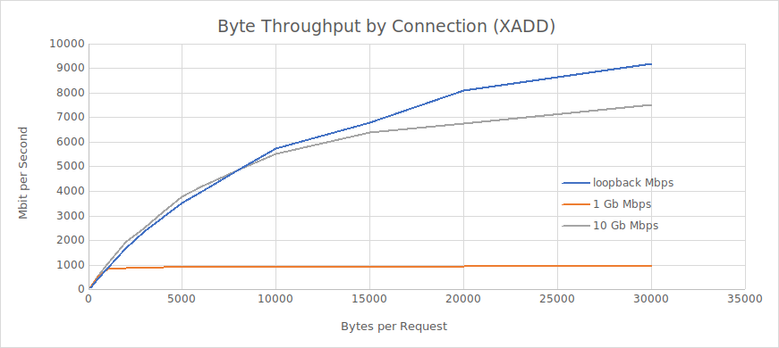
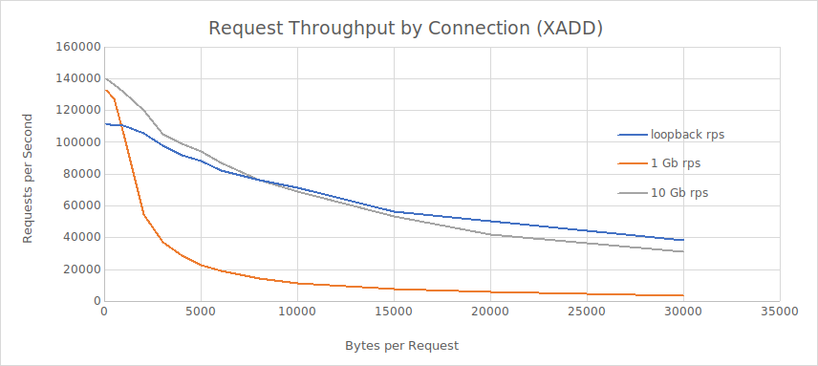
Benchmarks

Slide 16
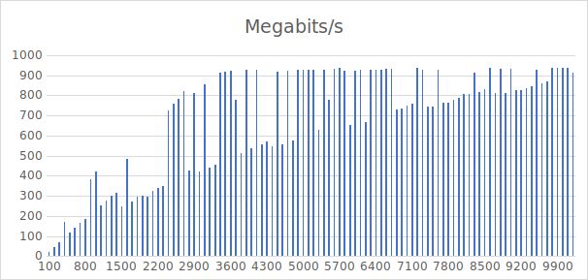
Benchmarks
UTCA AMC576

Slide 17
Redis (Danger Zone)– Lua and Javascript
Redis supports Lua and Javascript scripting, allowing you to execute a series of commands atomically. This can be useful for various purposes, such as to ensure data consistency, improve performance by reducing the number of round trips to the server, or implement more complex logic directly in Redis.
Write the script to a file
Load script
SCRIPT LOAD "$(cat increment_with_limit.lua)"
Use the returned hash to invoke the script
EVALSHA abc123 1 myKey 10
abc123 is the hash of our script.
1 is the number of keys we're passing to the script.
myKey is the key we want to increment.
10 is the limit after which we want to reset the key's value to zero.
-- increment_with_limit.lua local key = KEYS[1] local limit = tonumber(ARGV[1]) local value = tonumber(redis.call('GET', key) or '0') value = value + 1 if value > limit then value = 0 end redis.call('SET', key, value) return value

Slide 18
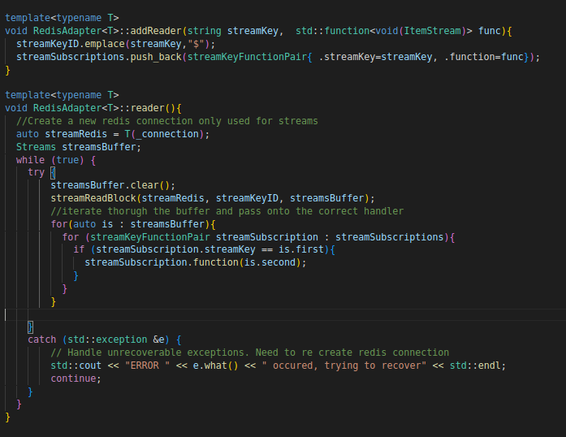
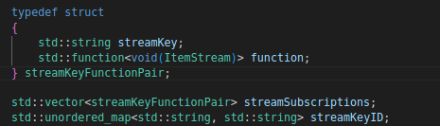
RedisAdapter - Stream Model

